Slide 1

CS 470 Project Two Conference Presentation: Cloud Development
Gregory Greene
October 2023

Slide 2
Overview
B.S. Computer Science, Southern New Hampshire University
Overview:
Containerization
Serverless Cloud Computing
API, Lambda, & Databases
Cloud based development
Security
Notes:
The purpose of this presentation is to articulate the intricacies of cloud development to both technical and nontechnical audiences.

Slide 3
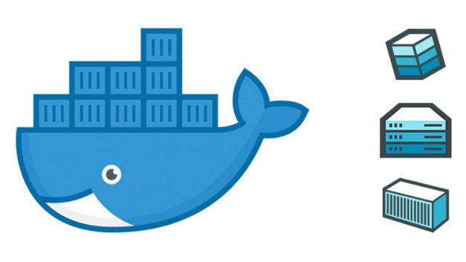
Containerization
Docker: A platform that supports containerization, allowing developers to package applications into a single container
Docker is used in cloud-based applications
Handles containers to simplify deployment and application management
Lift and Shift Model: Allows for easy migration to the cloud as the entire application is pushed to the cloud without making any changes to the code.

Slide 4
Orchestration
Docker Compose simplifies deployment of complex applications through the ability to manage multiple containers as a single stack.
Services required can be defined in a YAML file making setup easier
Docker Compose makes it easy to manage scaling, maintaining, and updating easier

Slide 5
The Serverless Cloud
What is “serverless” and what are its advantages?
What is S3 storage and how does it compare to local storage?
Required infrastructure is managed by the cloud service provider
Scaling is done by the cloud service
Reduces startup time and cost for developers
Amazon S3 is a cloud-based object storage service offered by AWS
Cloud based storage allows users to store and retrieve data from anywhere with a connection to the service
Provides security features to protect user’s data

Slide 6
The Serverless Cloud
API & Lambda
Serverless API allows for faster development, less resource use, and cost-efficiency
Lambda API logic involves the process of creating a RESTful API through AWS Lambda functions that will manage API requests and responses
What scripts are produced in order to make this happen?
Lambda functions, API gateway configurations, and request & response scripts
In order to integrate the frontend with the backend in AWS developers must define and test the API, connect the front/back ends, and implement data rendering

Slide 7
The Serverless Cloud
Database
What are the data-model differences between MongoDB and DynamoDB?
Differences between these two database types include: Scalability, Data Structure, and Querying. DynamoDB stores data based on key-values, while MongoDB uses document-oriented based storage.
What queries did you perform?
Queries performed include Get, Post, Push, Table scan, and Update/Delete item
What scripts are produced in order to make this happen?
Scripts produced include Lambda functions, API gateway configuration, and request/response scripts

Slide 8
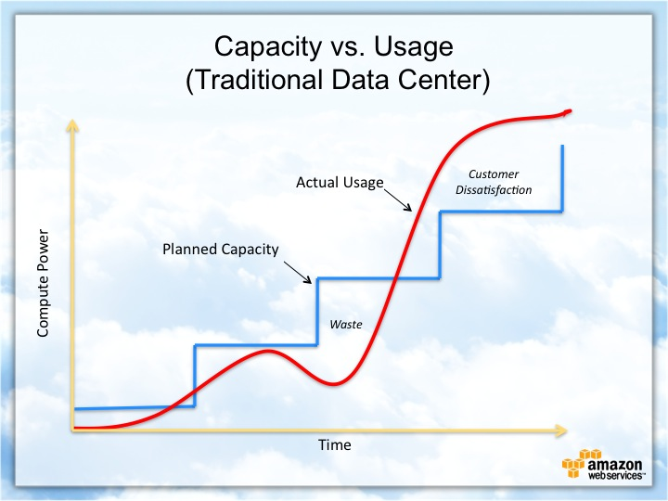
Cloud-Based Development Principles
Elasticity
Elasticity refers to how a cloud-based system can dynamically adapt to the number of resources being consumed. Systems can adjust to changes in traffic, amount of data being processed, or computing power required.
Allows for a system to scale according to the workload and reduce wasted resources
Pay-for-use model
A pricing model where consumers only pay for the resources used. Charges typically include storage, bandwidth, and computing power. This can be cost-efficient for smaller projects, as opposed to traditional fixed cost models.

Slide 9
Securing Your Cloud App
Access
Policies
API Security
How can you prevent unauthorized access?
Authentication
Frequent security and system updates
Defense in Depth
Explain the relationship between roles and policies.
Roles are created to define permissions needed by AWS to perform the intended functions.
Policies are created and assigned to Roles to specify the permissions given to a specific role.
This approach to development provides security through providing minimum required permissions for a role and reduce the risk of a role having unnecessary access to AWS resources.
Connection between Lambda and Gateway can be secured through AWS Identity and Access Management and API Gateway Authorization
Securing the database and AWS Lambda can be done through implementing Defense in Depth, including; minimum required permissions, AWS Identity and Access Management, and frequent policy verification and updates.
To secure the S3 Bucket Defense in depth can be implemented. Some possible security measurements include bucket policies, AWS Identity and Access Management, and Access Control Lists

Slide 10
Conclusion
Scalability
A major advantage of cloud development is the dynamic scaling managed by the cloud service. Resource management is handled by the cloud service based on traffic, storage needs, and computing power required at any given time.
Pay-for-Use Model
This model reduces startup cost as developers do not manage servers and only pay for the resources used. This can be a more cost-efficient model depending on the project size when compared to traditional fixed rate models.
Security
Cloud service providers typically include their own security measures to protect the database. Defense in Depth can be used through implementing security measures such as encryption and access control.
Thank you for your time.

